Slide 1

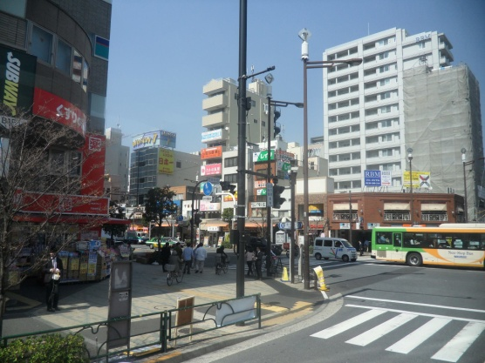
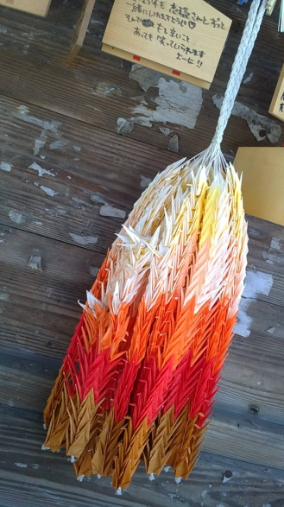
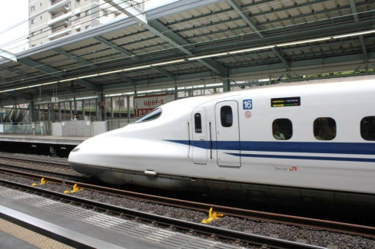
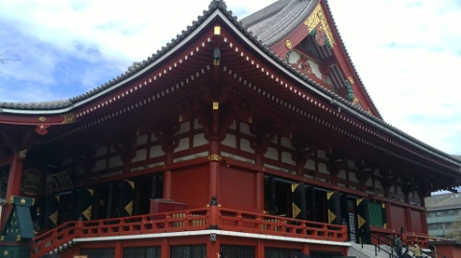
UP Japanology Society
ようこそ！
Orientation
Novermber 19, 2013

Slide 2

HISTORY
It was February 24, 2004, when 23 students and a professor, who shared a common interest in Japanese culture, established an organization committed in sharing this knowledge and interest.

Slide 3
ORG ACTIVITIES~<3

Slide 4

Shuuren
One of the org’s main activities that helps people to know more about the Japanese culture through vast activities in one event.

Slide 5

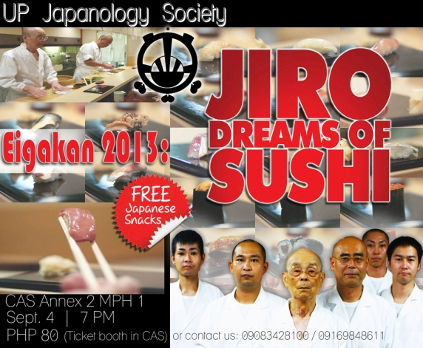

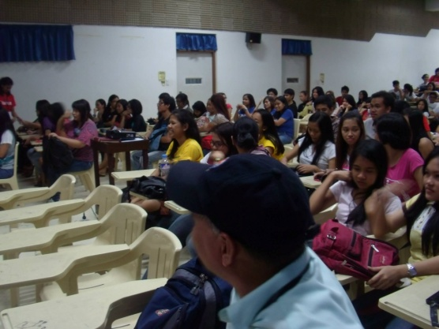
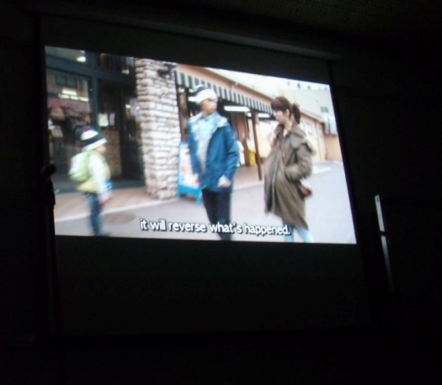
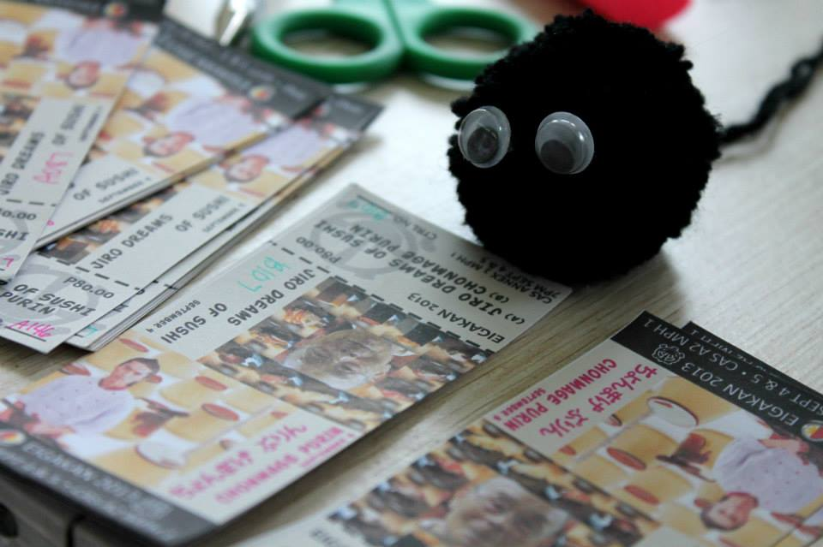
EIGAKAN
A film showing featuring the org’s picks of Japanese movies.

Slide 6
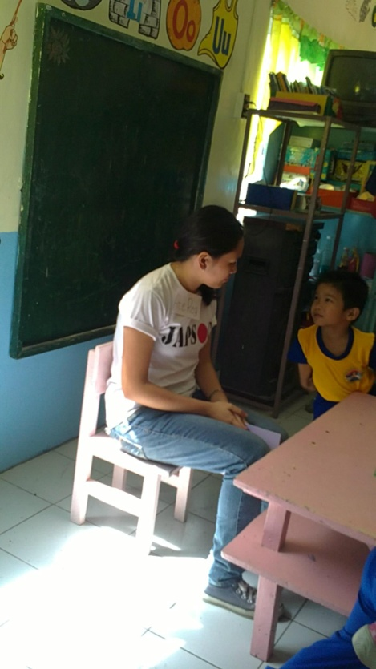
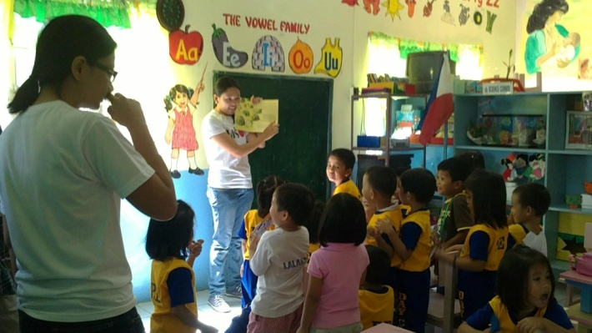
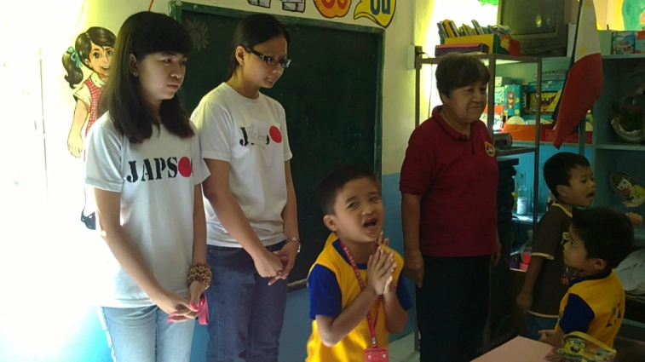
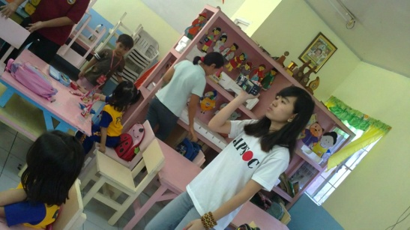
OUTREACH PROGRAMS
As a socio-civic organization, UP Japsoc does not only focused on culture-based activities but on outreach programs as well. Activities include tree planting, gift giving, etc.

Slide 7
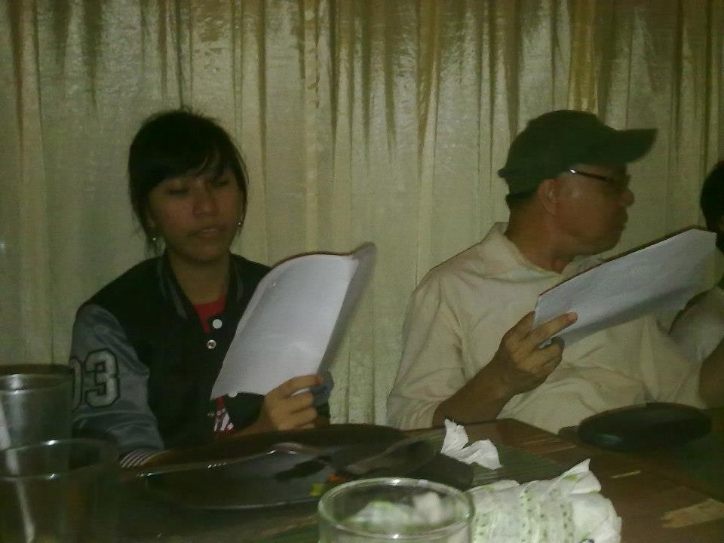
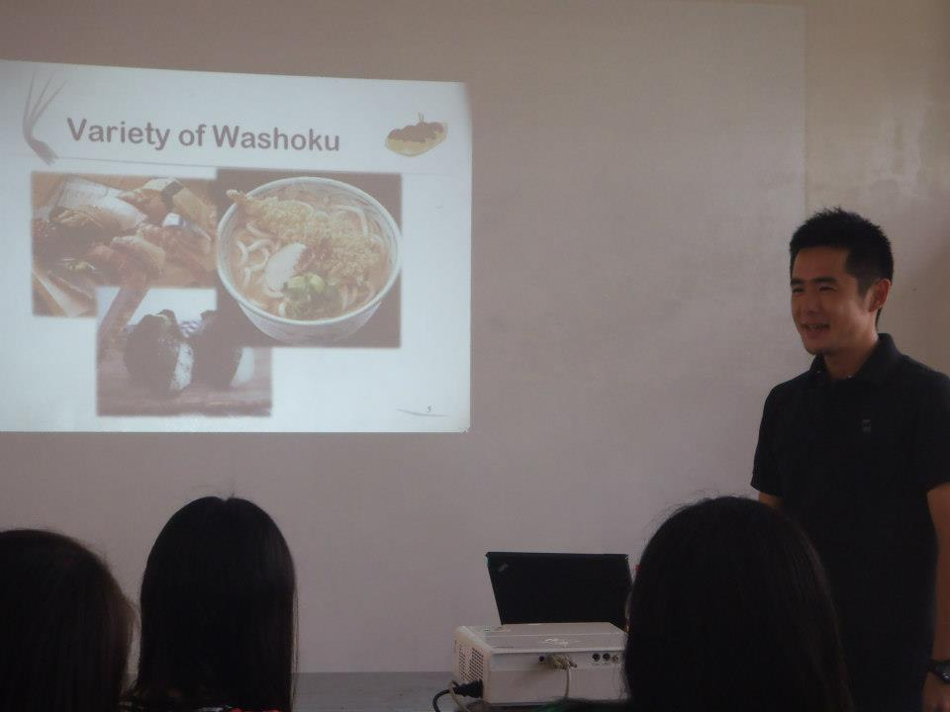
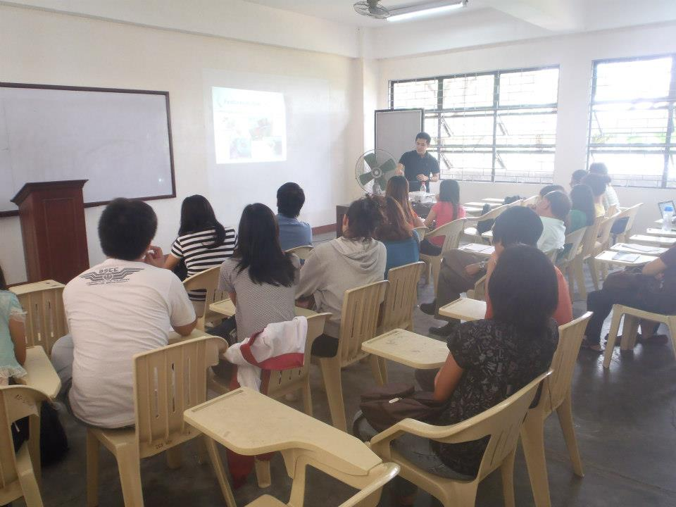
Seminars and tutorials

